Slide 1
Basic SQL: An introduction to basic SQL queries and operators
Cara Qin
August 15th, 2018

Slide 2
Overview
Purpose of this session is to provide a basic understanding of SQL
Class will include instructions on writing SELECT statements using various operators
Materials are geared towards using SQL Server as the database platform

Slide 3
CREATING TABLES
New tables can be created from scratch using a CREATE TABLE statement.
-- Creating Employee table
Create table Employee
(employee_ID int not null identity(1,1),
employee_name varchar(200) null,
hire_date date null)
insert into #employee(employee_name,hire_date)
values
('Jay Ollom','6/1/2000'),
('Tibarek Ejamo','4/30/2014'),
('David Barry','8/30/2006')
Many times we’ll create a new table “on the fly” though, based on the results of another select, using the INTO clause:
select * into #employee_2 from #employee where employee_id<>1;
select * from #employee_2

Slide 4
SELECT
A select statement is the way we retrieve or “query” data from a database table. It’s one of the most common statements you’ll use in SQL server scripting.
The most basic of select statements are structured like this:
SELECT [COLUMNS] FROM [TABLE]
Where the [COLUMNS] are the columns you want from the table, and [TABLE] is the name of the table you are selecting from.
Each column name is separated by a comma, e.g. employee_id, employee_name.
select employee_id, employee_name from #employee

Slide 5
Example Select
EMPLOYEE
employee_id | employee_name | hire_date
1 | Jay Ollom | 6/1/2000
2 | Tibarek Ejamo | 4/30/2012
3 | David Barry | 8/30/2006
Database Table
Will give you back:
employee_id | employee_name
1 | Jay Ollom
2 | Tibarek Ejamo
3 | David Barry
Note that we limited our columns
by excluding the “hire_date”

Slide 6
WHERE
EMPLOYEE
employee_id | employee_name | hire_date
1 | Jay Ollom | 6/1/2000
2 | Tibarek Ejamo | 4/30/2012
3 | David Barry | 8/30/2006
Database Table
We can further reduce the rows returned by using the WHERE clause:
Note: when working with string or date based fields, the value in the WHERE clause will need to be surrounded by single quotes.
Example:
SELECT employee_id, employee_name
FROM EMPLOYEE
WHERE employee_name = 'David Barry'
SELECT employee_id, employee_name
FROM EMPLOYEE
WHERE employee_id = 1
employee_id | employee_name
1 | Jay Ollom

Slide 7
LIKE
EMPLOYEE
employee_id | employee_name | hire_date
1 | Jay Ollom | 6/1/2000
2 | Tibarek Ejamo | 4/30/2012
3 | David Barry | 8/30/2006
Database Table
Like can be used when a wildcard effect is needed:
SELECT employee_id, employee_name
FROM EMPLOYEE
WHERE employee_name LIKE ‘David%'
Note: The % is used to allow for any character after the “d” in David to match the SQL request
employee_id | employee_name
3 | David Barry

Slide 8
JOINING TABLES
Joining data together across multiple tables is a slightly more advanced form of the SELECT clause.
EMPLOYEE_POSITION
employee_id | employee_position | position_start_date
1 | Sr. Developer | 6/1/2008
1 | Technical Lead | 6/1/2010
2 | Developer 2 | 4/30/2012
Here is a simple join to include the position(s) of each employee from the “EMPLOYEE_POSITION” table:
SELECT E.employee_name
, EP.employee_position
, EP.position_start_date
FROM EMPLOYEE E
JOIN EMPLOYEE_POSITION EP
ON E.employee_id = EP.employee_id
This is called an “alias”

Slide 9
Simple JOIN results
SELECT E.employee_name
, EP.employee_position
, EP.position_start_date
FROM EMPLOYEE E
JOIN EMPLOYEE_POSITION EP
ON E.employee_id = EP.employee_id
employee_name | employee_position | position_start_date
Jay Ollom | Sr. Developer | 6/1/2008
Jay Ollom | Technical Lead | 6/1/2010
Tibarek Ejamo | Developer 2 | 4/30/2012
From EMPLOYEE
From EMPLOYEE_POSITION
Notice that in this example we LOST employee “David Barry”, because he is not in the EMPLOYEE_POSITION table.

Slide 10
TYPES OF JOINS
There are different types of JOINS that we can use depending on what data we need from each of the tables.
INNER JOIN
OUTER JOIN
LEFT OUTER JOIN
RIGHT OUTER JOIN
FULL OUTER JOIN
CROSS JOIN(sometimes called a CARTESIAN JOIN)

Slide 11
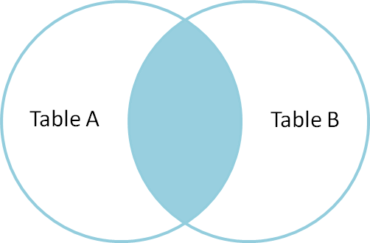
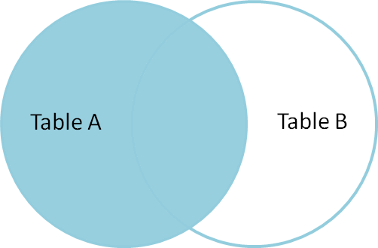
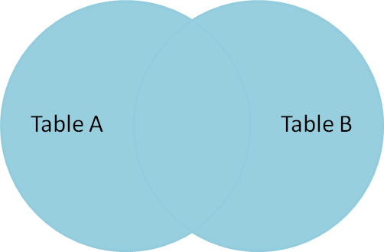
THE COMMON JOINS
SELECT E.employee_name
, EP.employee_position
, EP.position_start_date
FROM EMPLOYEE E
JOIN EMPLOYEE_POSITION EP
ON E.employee_id = EP.employee_id
INNER JOIN
LEFT OUTER JOIN
SELECT E.employee_name
, EP.employee_position
, EP.position_start_date
FROM EMPLOYEE E
LEFT JOIN EMPLOYEE_POSITION EP
ON E.employee_id = EP.employee_id
RIGHT OUTER JOIN
Is simply the inverse of a
LEFT OUTER JOIN
SELECT E.employee_name
, EP.employee_position
, EP.position_start_date
FROM EMPLOYEE E
FULL JOIN EMPLOYEE_POSITION EP
ON E.employee_id = EP.employee_id
FULL OUTER JOIN

Slide 12
THE CROSS JOIN
The CROSS or CARTESIAN JOIN is the strangest of the available JOIN options. It cannot be easily represented by a venn diagram.
It essentially joins EVERYTHING from TABLE A to TABLE B resulting in every possible combination of records from BOTH tables.
3 records in EMPLOYEE, 4 records in EMPLOYEE_POSITION 3 X 4 = 12 records returned in a CROSS JOIN
employee_name | employee_position | position_start_date
Jay Ollom | Sr. Developer | 6/1/2008
Jay Ollom | Technical Lead | 6/1/2010
Jay Ollom | Developer 2 | 4/30/2012
Jay Ollom | Developer 2 | 4/30/2069
Tibarek Ejamo | Sr. Developer | 6/1/2008
Tibarek Ejamo | Technical Lead | 6/1/2010
Tibarek Ejamo | Developer 2 | 4/30/2012
Tibarek Ejamo | Developer 2 | 4/30/2069
David Barry | Sr. Developer | 6/1/2008
David Barry | Technical Lead | 6/1/2010
David Barry | Developer 2 | 4/30/2012
David Barry | Developer 2 | 4/30/2069
SELECT E.employee_name
, EP.employee_position
, EP.position_start_date
FROM EMPLOYEE E
CROSS JOIN EMPLOYEE_POSITION EP
This join is of limited use in our world.

Slide 13
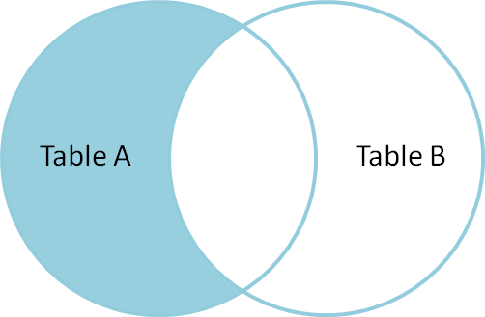
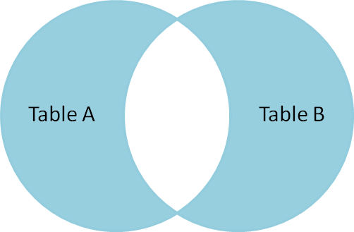
SOME COMMON JOIN “TRICKS”
One of the more common things we need to find out, is when data is available on one side (in one table) but not the other.
SELECT E.employee_name
, EP.employee_position
, EP.position_start_date
FROM EMPLOYEE E
LEFT JOIN EMPLOYEE_POSITION EP
ON E.employee_id = EP.employee_id
WHERE EP.employee_id IS NULL
LEFT/RIGHT OUTER JOIN
WITH EXCLUSION
Records in one table, but not present in the other.
SELECT E.employee_name
, EP.employee_position
, EP.position_start_date
FROM EMPLOYEE E
FULL JOIN EMPLOYEE_POSITION EP
ON E.employee_id = EP.employee_id
WHERE E.employee_id IS NULL
or EP.employee_id IS NULL
FULL OUTER JOIN
WITH EXCLUSION
Records that are NOT common across the tables (that DON’T match)

Slide 14
OPERATORS
Operators specify how to filter the results typically in WHERE and JOIN conditions
Some common operators include:
Equal / Not Equal: allows a single value to be specified in the WHERE clause
IN / NOT IN: allows multiple values to be specified in the WHERE clause
AND / OR: allows multiple condition statements to be specified

Slide 15
OPERATORS – EQUAL / NOT EQUAL, GREATER/LESS THAN
EMPLOYEE
employee_id | employee_name | hire_date
1 | Jay Ollom | 6/1/2000
2 | Tibarek Ejamo | 4/30/2012
3 | David Barry | 8/30/2006
Database Table
EQUAL:
NOT EQUAL:
SELECT employee_id, employee_name
FROM EMPLOYEE
WHERE employee_id = 1
SELECT employee_id, employee_name
FROM EMPLOYEE
WHERE employee_id <> 1
employee_id | employee_name
1 | Jay Ollom
employee_id | employee_name
2 | Tibarek Ejamo
3 | David Barry

Slide 16
OPERATORS – EQUAL / NOT EQUAL, GREATER/LESS THAN
EMPLOYEE
employee_id | employee_name | hire_date
1 | Jay Ollom | 6/1/2000
2 | Tibarek Ejamo | 4/30/2012
3 | David Barry | 8/30/2006
Database Table
GREATER THAN:
LESS THAN OR EQUAL:
SELECT employee_id, employee_name
FROM EMPLOYEE
WHERE employee_id > 2
SELECT employee_id, employee_name
FROM EMPLOYEE
WHERE employee_id <= 2
employee_id | employee_name
3 | David Barry
employee_id | employee_name
1 | Jay Ollom
2 | Tibarek Ejamo

Slide 17
OPERATORS – IN / NOT IN
EMPLOYEE
employee_id | employee_name | hire_date
1 | Jay Ollom | 6/1/2000
2 | Tibarek Ejamo | 4/30/2012
3 | David Barry | 8/30/2006
Database Table
IN:
NOT IN:
SELECT employee_id, employee_name
FROM EMPLOYEE
WHERE employee_id IN (1, 2)
SELECT employee_id, employee_name
FROM EMPLOYEE
WHERE employee_id NOT IN (1,2)
employee_id | employee_name
1 | Jay Ollom
2 | Tibarek Ejamo
employee_id | employee_name
3 | David Barry

Slide 18
OPERATORS – AND
EMPLOYEE
employee_id | employee_name | hire_date
1 | Jay Ollom | 6/1/2000
2 | Tibarek Ejamo | 4/30/2012
3 | David Barry | 8/30/2006
Database Table
AND:
OR:
SELECT employee_id, employee_name
FROM EMPLOYEE
WHERE employee_id IN (3)
AND employee_name = 'David Barry'
SELECT employee_id, employee_name
FROM EMPLOYEE
WHERE employee_id IN (1)
OR employee_name = 'David Barry'
employee_id | employee_name
3 | David Barry
employee_id | employee_name
1 | Jay Ollom
3 | David Barry

Slide 19
ORDER BY
ORDER BY: Used to sort the returned record
EMPLOYEE
employee_id | employee_name | hire_date
1 | Jay Ollom | 6/1/2000
2 | Tibarek Ejamo | 4/30/2012
3 | David Barry | 8/30/2006
Database Table
SELECT employee_id, employee_name, hire_date
FROM EMPLOYEE
ORDER BY hire_date ASC
Note: Order by can be specified as ascending (ASC) or descending (DESC)
Will give you back:
employee_id | employee_name | hire_date
1 | Jay Ollom | 6/1/2000
3 | David Barry | 8/30/2006
2 | Tibarek Ejamo | 4/30/2012

Slide 20
CASE
CASE: used to evaluate a list of conditions and return one of multiple possible results sets.
EMPLOYEE
employee_id | employee_name | hire_date
1 | Jay Ollom | 6/1/2000
2 | Tibarek Ejamo | 4/30/2012
3 | David Barry | 8/30/2006
Database Table
SELECT employee_name ,
CASE WHEN hire_date > ' 1/1/2012 '
THEN 'New Hire '
ELSE 'Not New Hire'
END AS employee_status
FROM EMPLOYEE
Will give you back:
employee_name | Employee_status
Jay Ollom | Not New Hire
Tibarek Ejamo | New Hire
David Barry | Not New Hire

Slide 21
UNION
Union is used to combine two record sets into one overall set
EMPLOYEE
employee_id | employee_name | hire_date
1 | Jay Ollom | 6/1/2000
2 | Tibarek Ejamo | 4/30/2012
3 | David Barry | 8/30/2006
Note: UNION will de-dupe any duplicate records from the returned result set. If this is not desired, UNION ALL may be used to retain duplicate records
SELECT employee_id, employee_name
FROM EMPLOYEE
WHERE employee_id = 1
UNION
SELECT employee_id, employee_name
FROM EMPLOYEE
WHERE employee_id = 3
Results
employee_id | employee_name
1 | Jay Ollom
3 | David Barry

Slide 22
UPDATE
UPDATE statements are used to change the data in tables.
UPDATE EMPLOYEE
SET employee_name = ‘Loren Ollom’
WHERE employee_name = ‘Jay Ollom’
UPDATE statements can also be based on a FROM clause. Typically, this would include a JOIN.
UPDATE EMPLOYEE
SET employee_name = OE.employee_name
FROM EMPLOYEE E
JOIN OTHER_EMPLOYEES OE
ON E.employee_id = OE.employee_id
WHERE E.employee_name <> OE.employee_name
When updating and deleting data, the WHERE clause is extremely important!

Slide 23
DELETE
We don’t delete a lot of stuff at Merkle, so don’t expect to see this too often!
DELETE EMPLOYEE
WHERE employee_id = 1
Deletes can also be based on more complex JOIN logic.
DELETE EMPLOYEE
FROM EMPLOYEE E
LEFT JOIN EMPLOYEE_POSITION EP
ON E.employee_id = EP.employee_id
WHERE EP.employee_id IS NULL

Slide 24
Give it a shot!

Slide 25

SQL Server Management Studio
SQL Server Management Studio is an application to write SQL queries against a database
Launch the Program:
Start > All Programs > Microsoft SQL Server 2008 > SQL Server Management Studio
This will Open SQL Server Management Studio

Slide 26
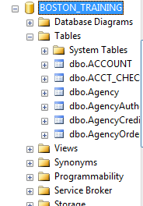
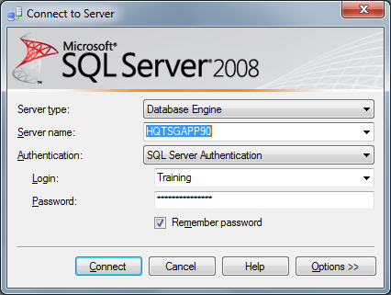
SQL Server Management Studio
Logging in:
Server: HQTSGAPP90
User: Training
Password: Training
Use BOSTON_TRAINING database

Slide 27
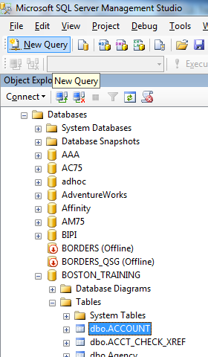
SQL Server Management Studio
Create a query
Click “New Query”

Slide 28
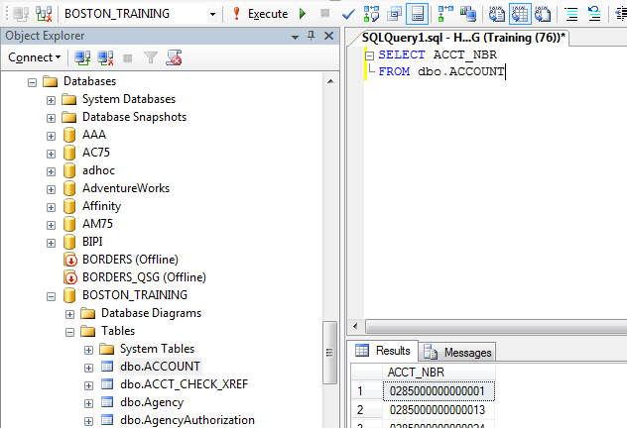
SQL Server Management Studio
Write SQL in query window, click “Execute” to run
2. Execute
1. Query Window
3. Results

Slide 29
Netezza SQL – System Tables
Tables
_v_table
Columns
_v_relation_column
Procedures
_v_procedure
Select * from _v_table where tablename=‘’;
Select * from _v_relation_column where name=‘’;
Select * from _v_procedure where procedure=‘’;

